Slide 1

WEBSITE OF LAW FIRM MANAGEMENT SYSTEM
CAPSTONE PROJECT

Slide 2
SUPERVISOR:
TEAM MEMBERS:
NGUYEN VAN SANG
LE DUY HOANG
DANG NGUYEN KHIEM
TRAN ANH TUAN
PHAM VAN DUY

Slide 3

CONTENTS
REQUIREMENT
CORE FLOW
01 REQUIREMENT
02 PROBLEM
03 SOLUTION
04 PROJECT
05 CORE FLOW
PROJECT
PROBLEM
SOLUTION

Slide 4
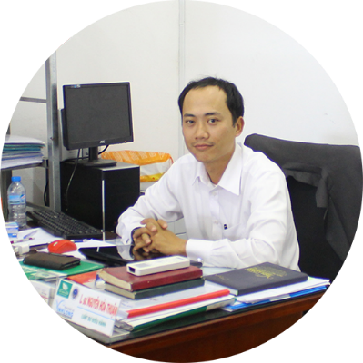
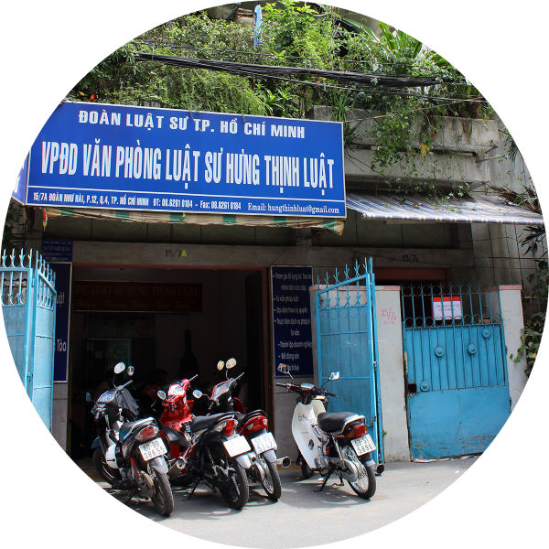
REQUIREMENT
This project get requirements from "Thuan Nguyen Lawyer Office" in Vinh Long City. The majority of this project is to use internal systems used to manage Office, Service, Staff, Customer, Case Management, Consulting, Contract and Reports…
Existing solution is to go for the actual project, met the manager of law office, Mr. Thuan. And then get actual requirements for project.
Manager of

Slide 5
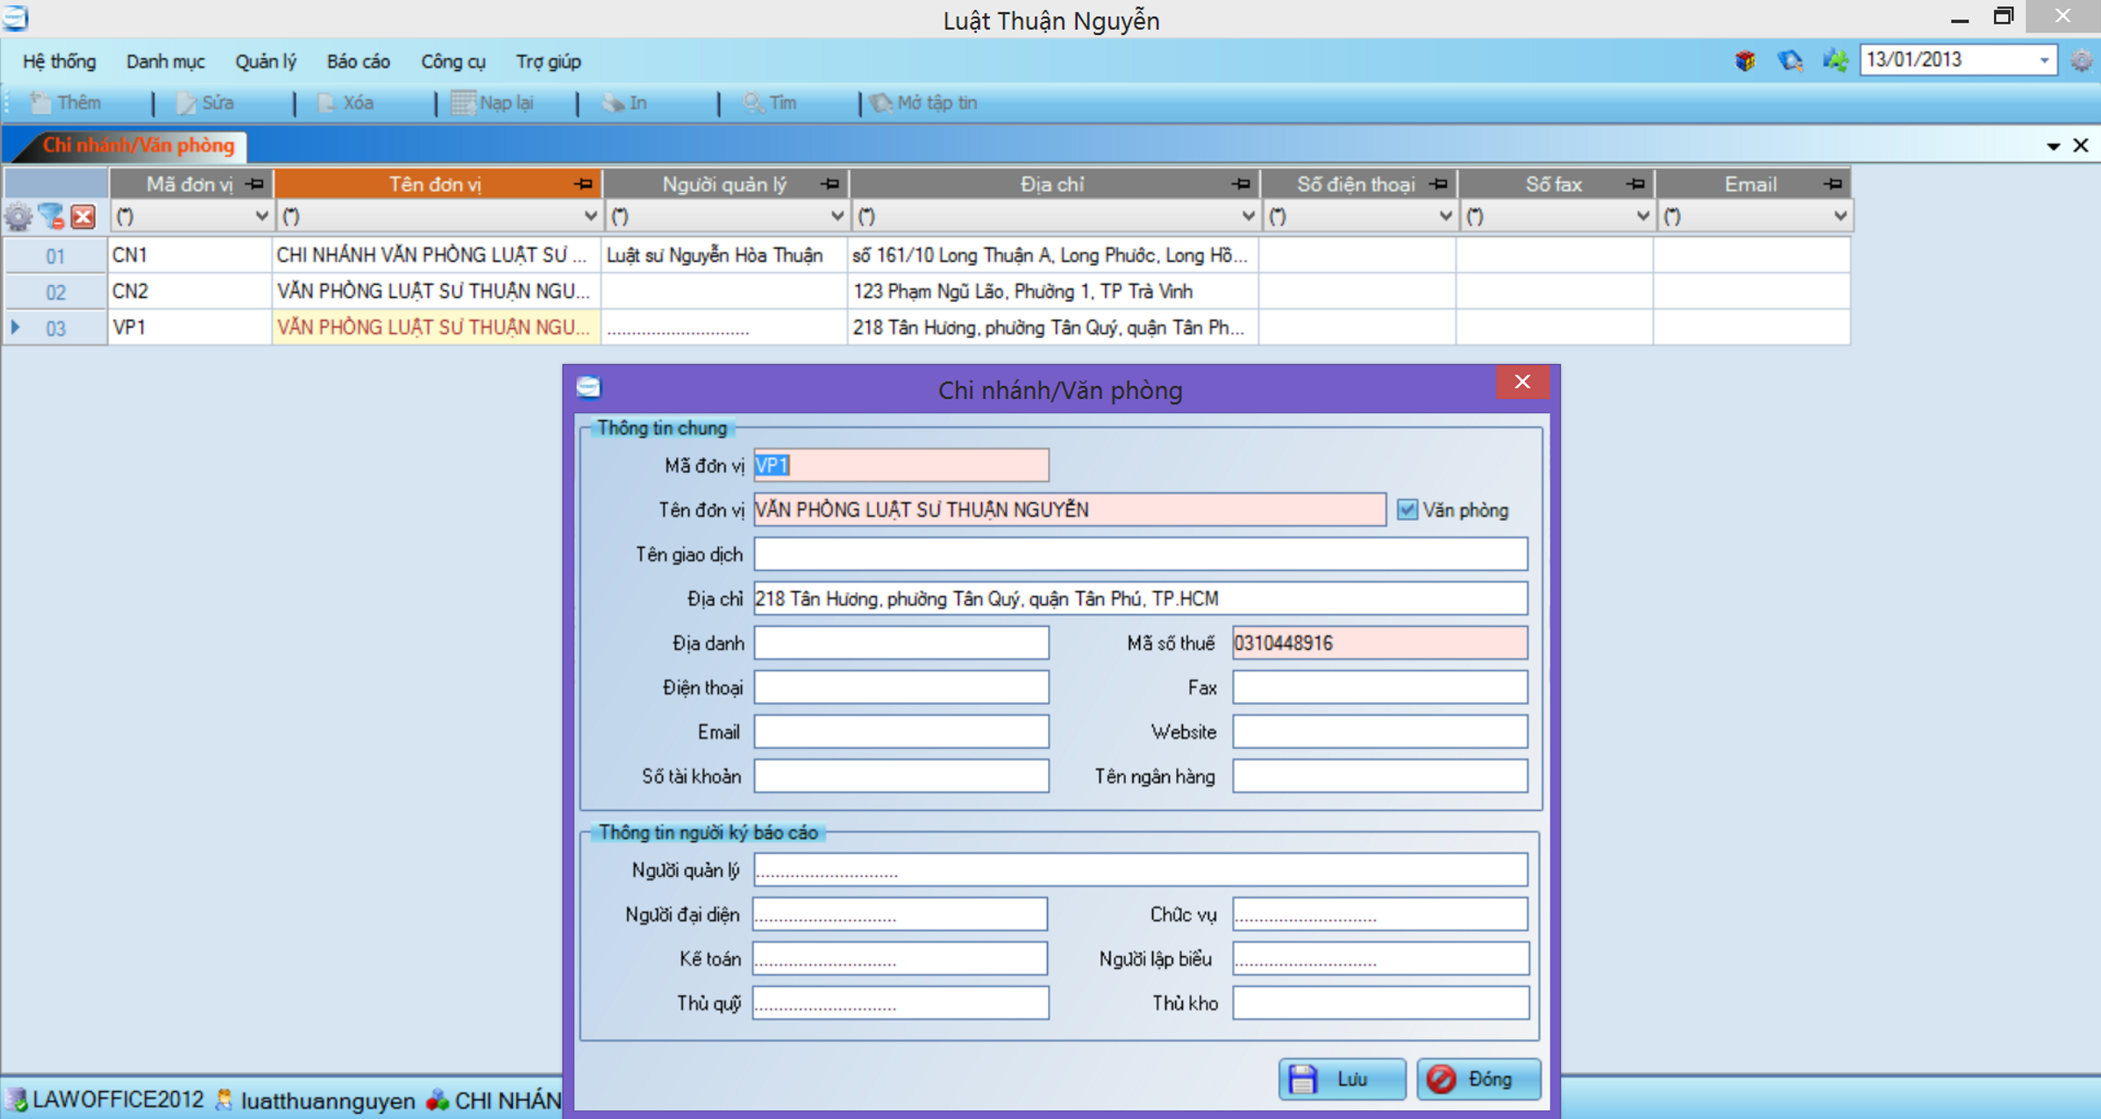
PROBLEM / Current System

Slide 6





PROBLEM / Current System
Many errors occur
Difficult to upgrade or maintain
Limit number of devices can use
Manage only 1 office
Manage with only text information

Slide 7

SOLUTION / LFMS
Steady running
Easy upgrade and maintenance
Multiple devices can use at the same time
Can be used for many types of office
Manage multimedia data

Slide 8









PROJECT / Tools and Techniques

Slide 9
PROJECT / MVC Architectural Design

Slide 10


PROJECT / Future Plan
Use Android App
To Locate by GPS

Slide 11
PROJECT / User Role
Admin
Creator
Viewer

Slide 12
PROJECT / Functional Requirement
LFMS
Manage Office
Manage Staff
Manage Service
Manage Customer
Manage Case
Manage Calendar Event
Manage Case Info
Manage Operation Event
Manage People Related
Manage Document Related
Manage Invoice
Integrate Thu Vien Phap Luat
Manage Salary
Statistic
Manage Other Cost

Slide 13
PROJECT / Functional Requirement
LFMS
Manage Salary
Statistic
Manage Assurance
Manage Tax
Manage Impress
Manage Time Sheet
Integrate Reward
Manage Other Cost
Manage Benefit
Calculate Salary

Slide 14
PROJECT / Functional Requirement
LFMS
Statistic
Office Statistic
Staff Statistic
Manage Other Cost
Revenue Statistic
Manage Salary

Slide 15
Core Flow
Add New Case
Assign Lawyer
Update Case Detail

Slide 16
LFMS
Thank You !

